Slide 1
Convolutional Neural Network

Slide 2
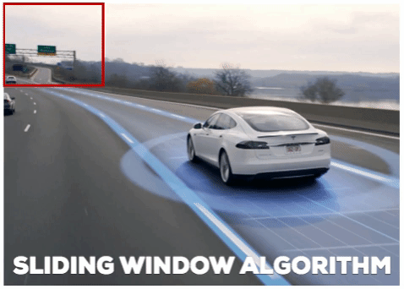

Slide 3
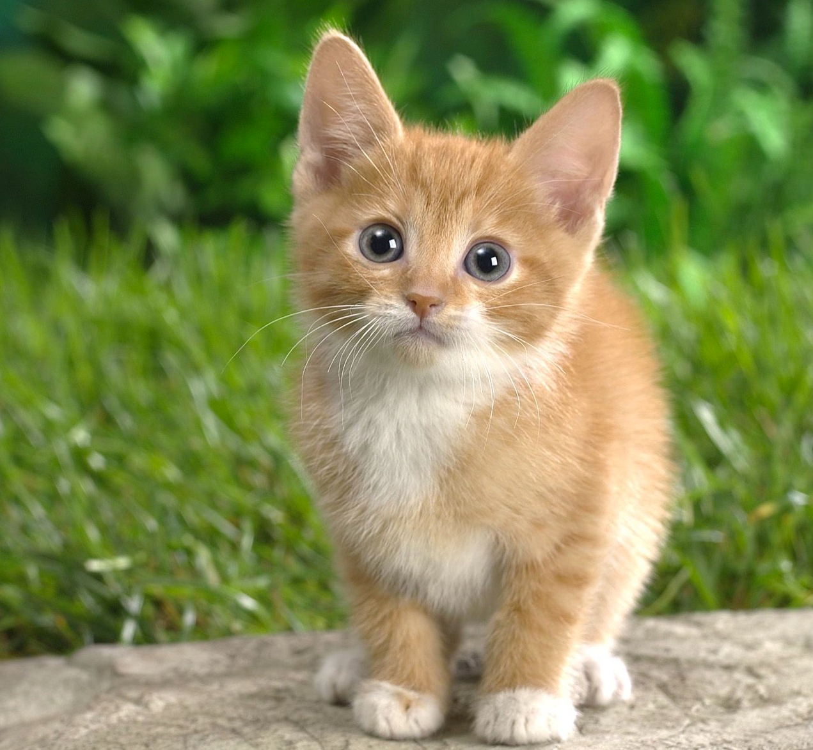
Sliding Window: Overfeat
0.5
Network input: 3 x 221 x 221
Larger image: 3 x 257 x 257
Classification scores: P(cat)
3

Slide 4
Sliding Window: Overfeat
0.5 | 0.75
Network input: 3 x 221 x 221
Larger image: 3 x 257 x 257
Classification scores: P(cat)
4

Slide 5
Sliding Window: Overfeat
0.5 | 0.75
0.6
Network input: 3 x 221 x 221
Larger image: 3 x 257 x 257
Classification scores: P(cat)
5

Slide 6
Sliding Window: Overfeat
0.5 | 0.75
0.6 | 0.8
Network input: 3 x 221 x 221
Larger image: 3 x 257 x 257
Classification scores: P(cat)
6

Slide 7
Sliding Window: Overfeat
0.5 | 0.75
0.6 | 0.8
Network input: 3 x 221 x 221
Larger image: 3 x 257 x 257
Classification scores: P(cat)
7

Slide 8
Sliding Window: Overfeat
Greedily merge boxes and scores (details in paper)
0.8
Network input: 3 x 221 x 221
Larger image: 3 x 257 x 257
Classification score: P(cat)
8

Slide 9

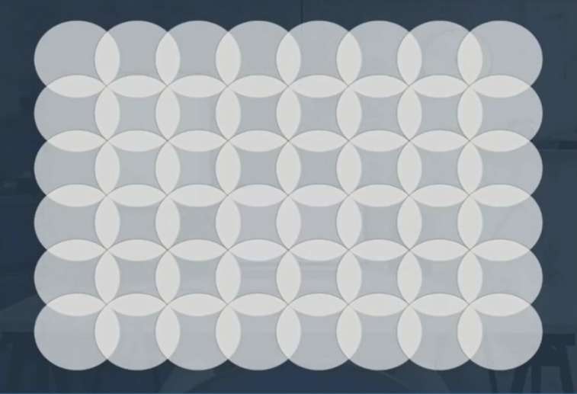

Slide 10
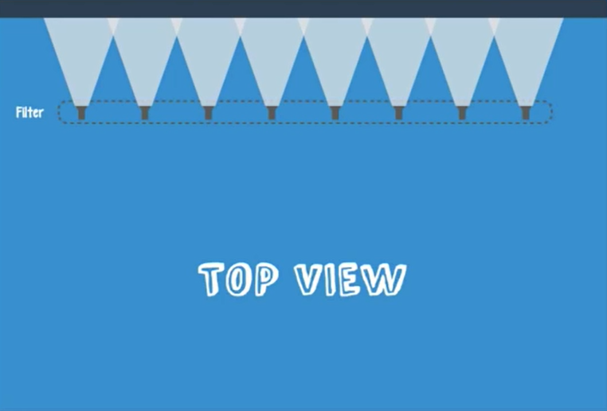

Slide 11
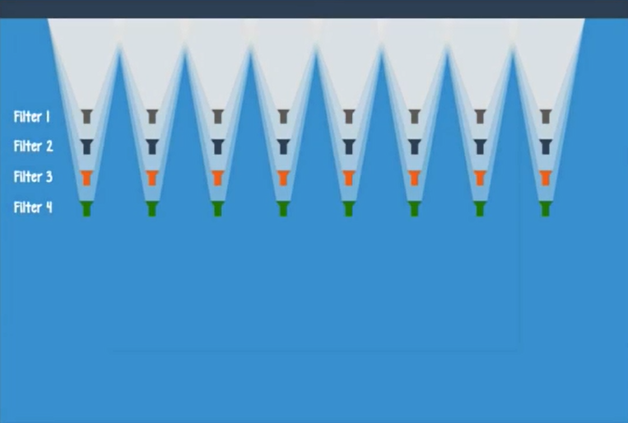

Slide 12
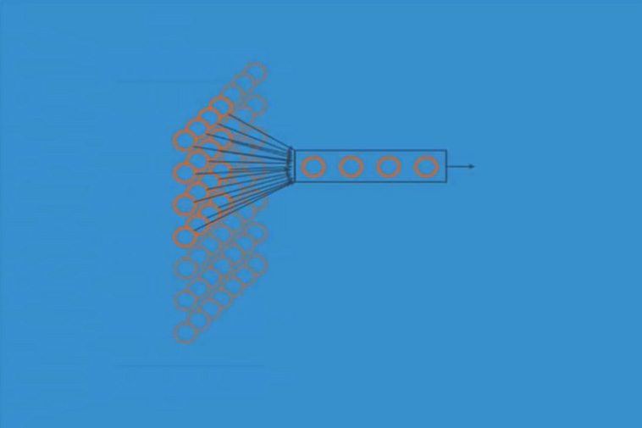
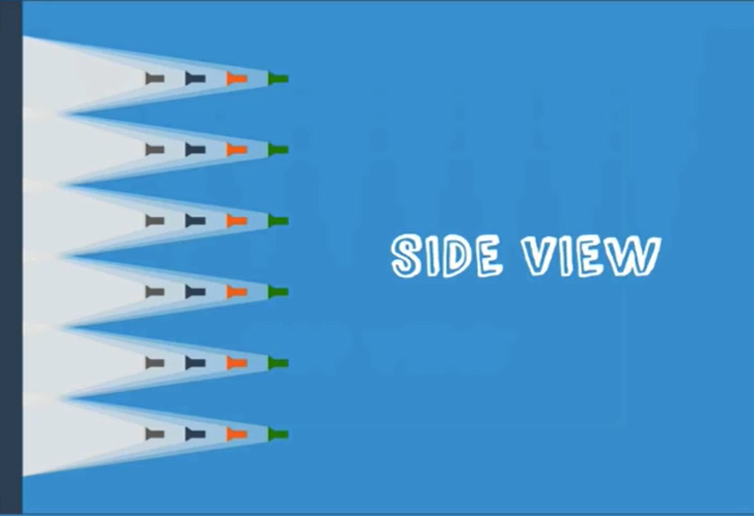
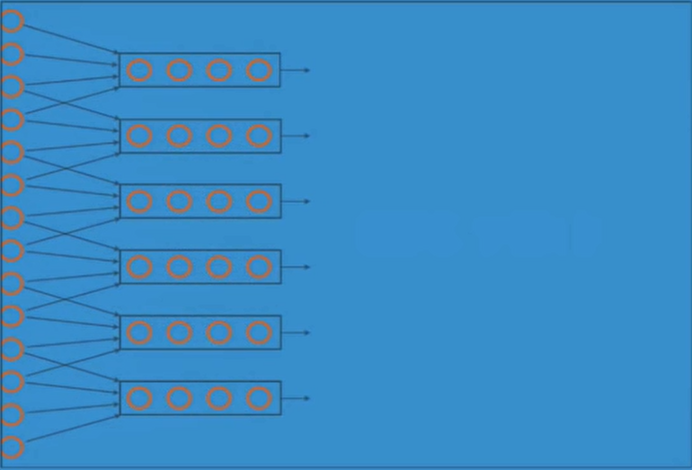
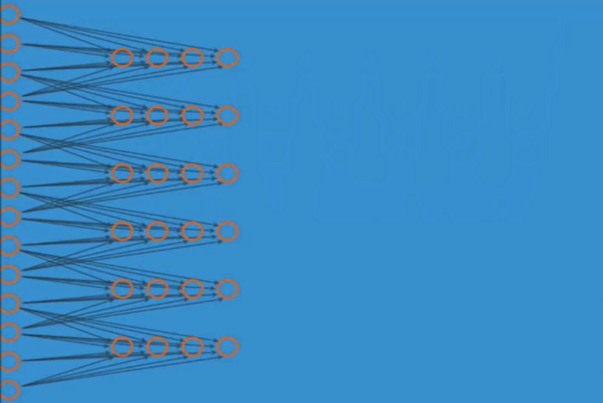

Slide 13
Convolution Layer
32x32x3 image
32
height
32
width
3
depth

Slide 14
Convolution Layer
32x32x3 image
5x5x3 filter
32
Convolve the filter with the image
i.e. “slide over the image spatially, computing dot products”
32
3

Slide 15
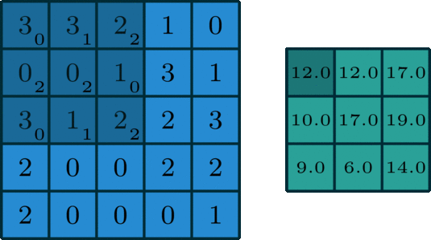
Convolution Layer

Slide 16
Convolution Layer
Filters always extend the full depth of the input volume
32x32x3 image
5x5x3 filter
32
Convolve the filter with the image
i.e. “slide over the image spatially, computing dot products”
32
3
16

Slide 17
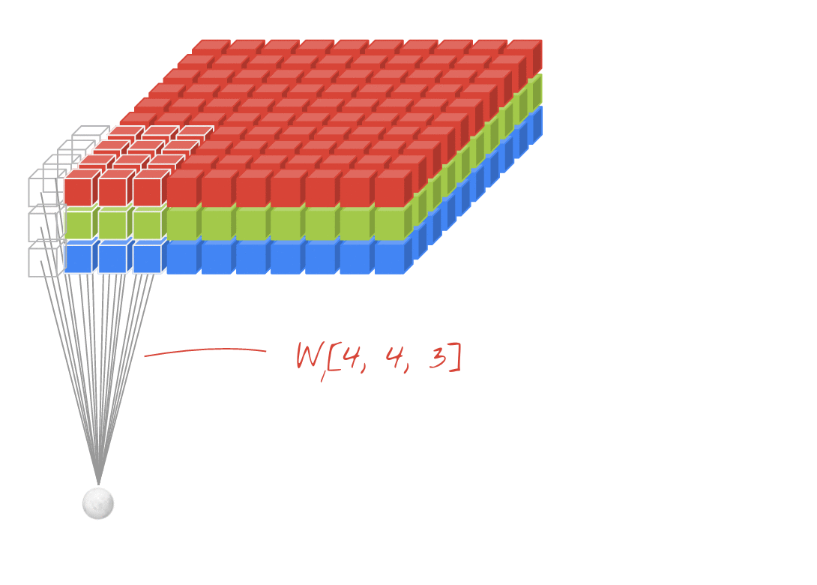
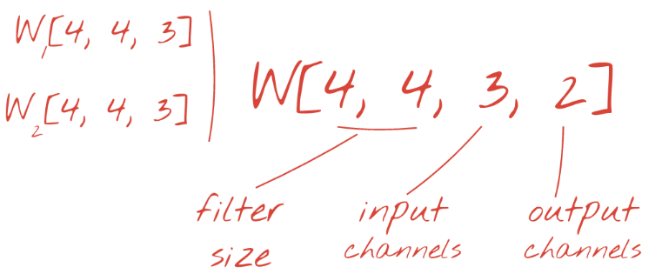

Slide 18
Convolution Layer
activation map
32x32x3 image
5x5x3 filter
32
28
convolve (slide) over all spatial locations
32
28
3
1
18

Slide 19
consider a second, green filter
Convolution Layer
32x32x3 image
5x5x3 filter
activation maps
32
28
convolve (slide) over all spatial locations
32
28
3
1
19

Slide 20
For example, if we had 6 5x5 filters, we’ll get 6 separate activation maps:
activation maps
32
28
Convolution Layer
32
28
3
6
We stack these up to get a “new image” of size 28x28x6!
20

Slide 21
Preview: ConvNet is a sequence of Convolution Layers, interspersed with activation functions
32
28
CONV,
ReLU
e.g. 6 5x5x3 filters
32
28
3
6
21

Slide 22
Preview: ConvNet is a sequence of Convolutional Layers, interspersed with activation functions
32
28
24
….
CONV,
ReLU
e.g. 6 5x5x3 filters
CONV,
ReLU
e.g. 10 5x5x6 filters
CONV,
ReLU
32
28
24
3
6
10
22

Slide 23


Slide 24

The brain/neuron view of CONV Layer
32x32x3 image
5x5x3 filter
32
It’s just a neuron with local connectivity...
1 number:
the result of taking a dot product between the filter and this part of the image
(i.e. 5*5*3 = 75-dimensional dot product)
32
3
24

Slide 25

Pooling layer
makes the representations smaller and more manageable
operates over each activation map independently:
25

Slide 26
MAX POOLING
Single depth slice
1 | 1 | 2 | 4
5 | 6 | 7 | 8
3 | 2 | 1 | 0
1 | 2 | 3 | 4
x
max pool with 2x2 filters and stride 2
6 | 8
3 | 4
y
26

Slide 27

Fully Connected Layer (FC layer)
Contains neurons that connect to the entire input volume, as in ordinary Neural Networks
27

Slide 28

28

Slide 29
Imagenet challenge

Slide 30

Case Study: LeNet-5
[LeCun et al., 1998]
Conv filters were 5x5, applied at stride 1
Subsampling (Pooling) layers were 2x2 applied at stride 2
i.e. architecture is [CONV-POOL-CONV-POOL-CONV-FC]
30

Slide 31
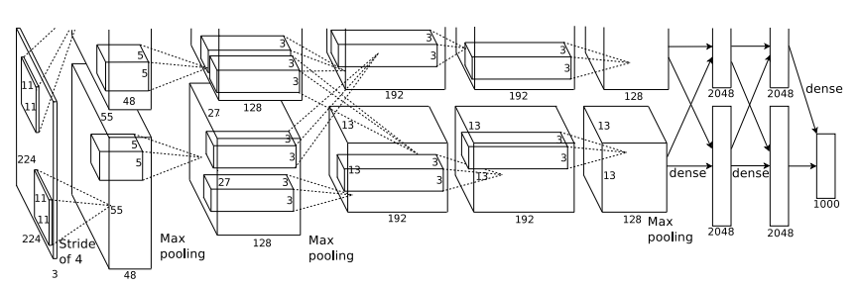
Case Study: AlexNet
[Krizhevsky et al. 2012]
Input: 227x227x3 images
First layer (CONV1): 96 11x11 filters applied at stride 4
=>
Q: what is the output volume size? Hint: (227-11)/4+1 = 55
31

Slide 32
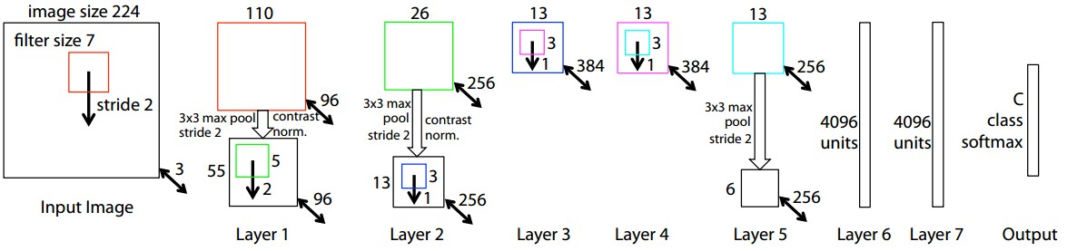
Case Study: ZFNet
[Zeiler and Fergus, 2013]
AlexNet but:
CONV1: change from (11x11 stride 4) to (7x7 stride 2)
CONV3,4,5: instead of 384, 384, 256 filters use 512, 1024, 512
ImageNet top 5 error: 15.4% -> 14.8%
32

Slide 33

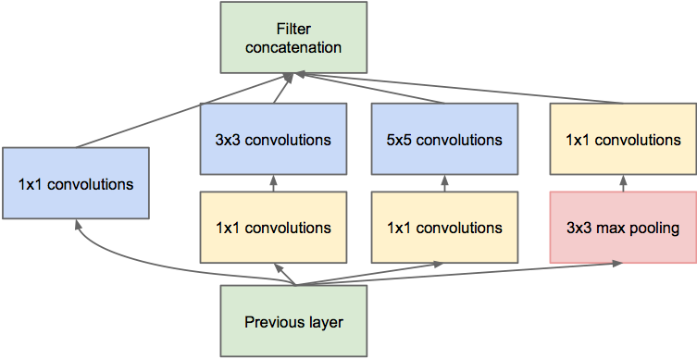
[Szegedy et al., 2014]
Case Study: GoogLeNet
Inception module
ILSVRC 2014 winner (6.7% top 5 error)
33

Slide 34
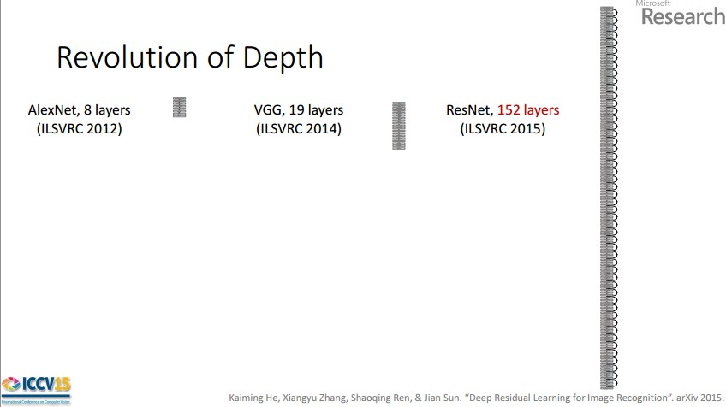
Case Study: ResNet
[He et al., 2015]
ILSVRC 2015 winner (3.6% top 5 error)
2-3 weeks of training on 8 GPU machine
at runtime: faster than a VGGNet! (even though it has 8x more layers)
34

Slide 35
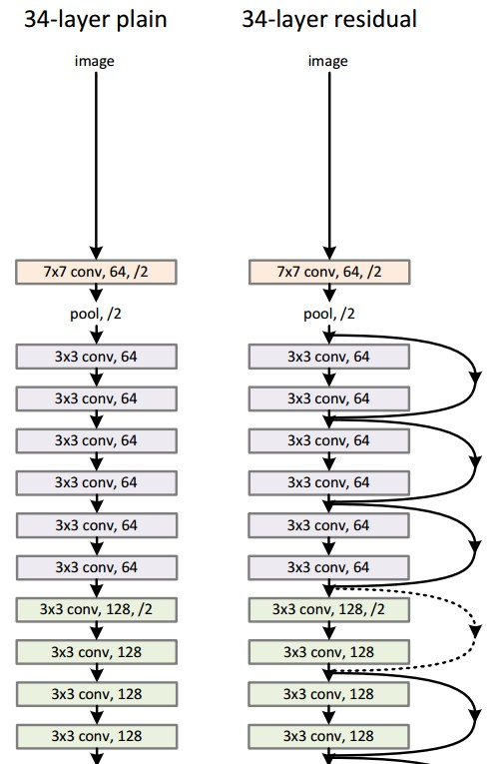
Case Study:
ResNet
224x224x3
spatial dimension only 56x56!
[He et al., 2015]
35

Slide 36
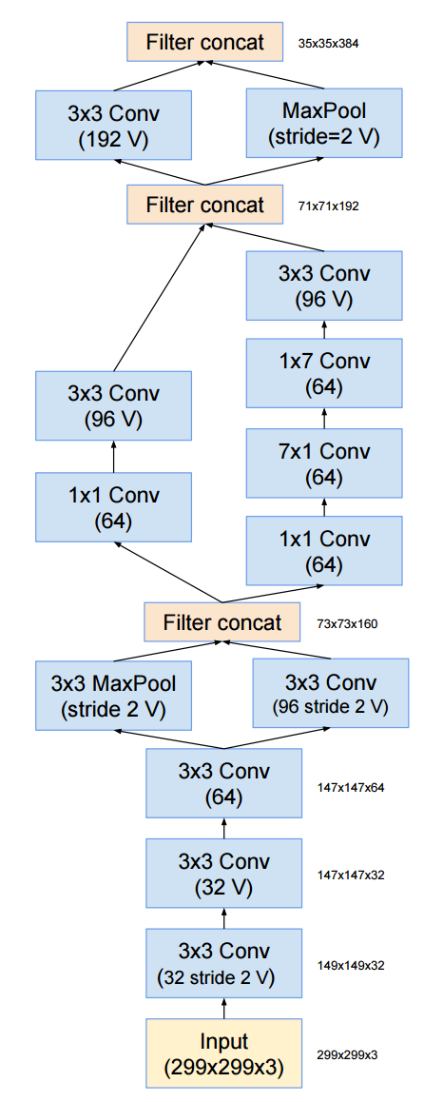
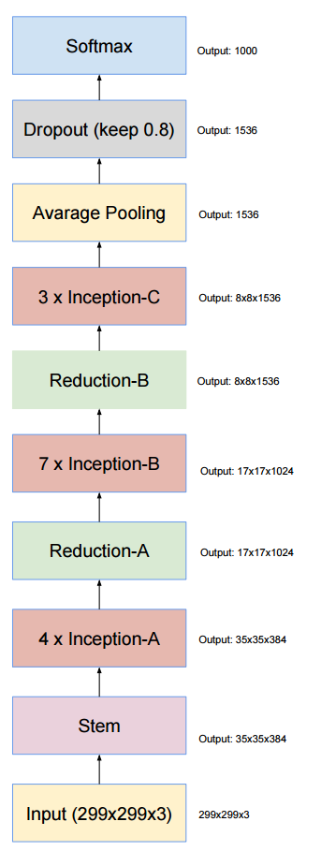
Inception-v4
1x7, 7x1 filters
Strided convolution AND max pooling
V = Valid convolutions (no padding)
9 layers
Szegedy et al, Inception-v4, Inception-ResNet and the Impact of Residual Connections on Learning, arXiv 2016
36

Slide 37
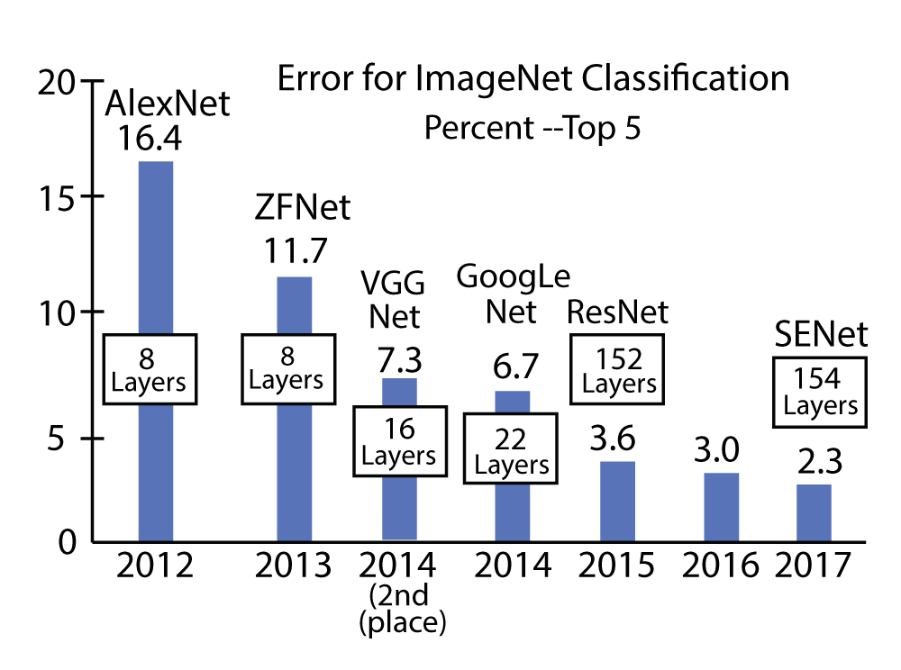
Szegedy et al, Inception-v4, Inception-ResNet and the Impact of Residual Connections on Learning, arXiv 2016
37

Slide 38
CNN are everywhere!!

Slide 39
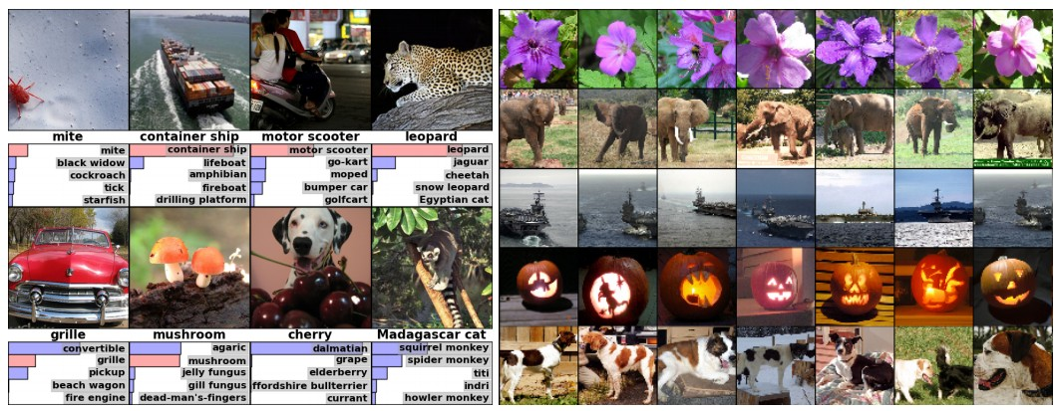
Fast-forward to today: ConvNets are everywhere
Classification
Retrieval
[Krizhevsky 2012]
39

Slide 40
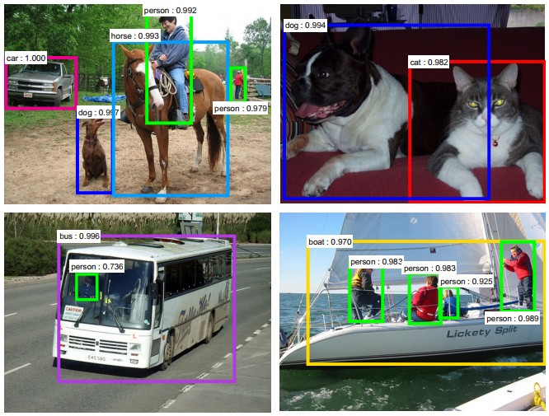
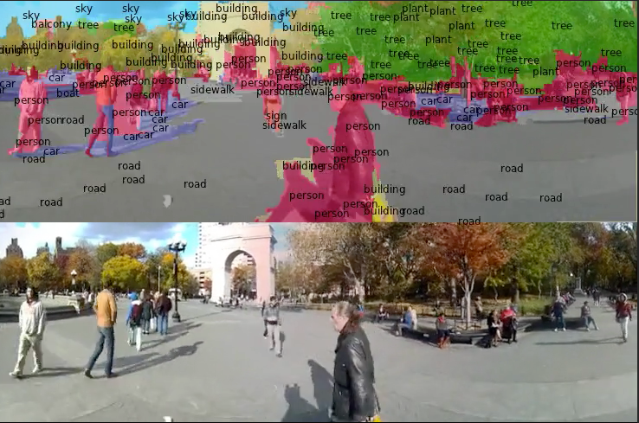
Fast-forward to today: ConvNets are everywhere
Detection
Segmentation
[Faster R-CNN: Ren, He, Girshick, Sun 2015]
[Farabet et al., 2012]
40

Slide 41
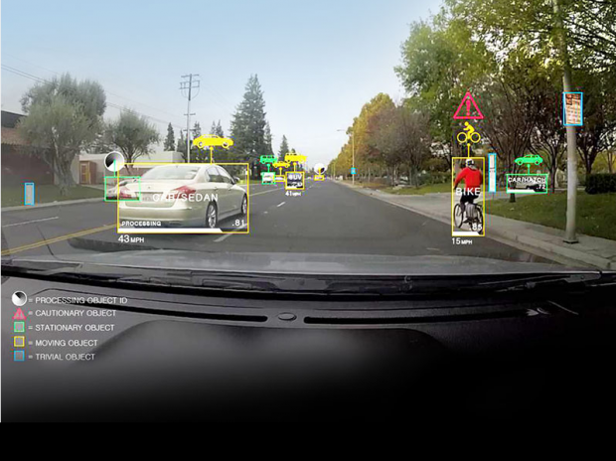
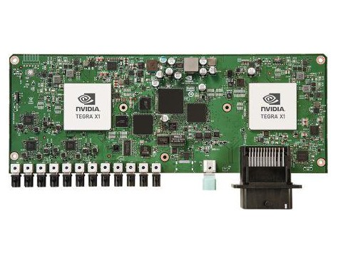
Fast-forward to today: ConvNets are everywhere
NVIDIA Tegra X1
self-driving cars
41

Slide 42
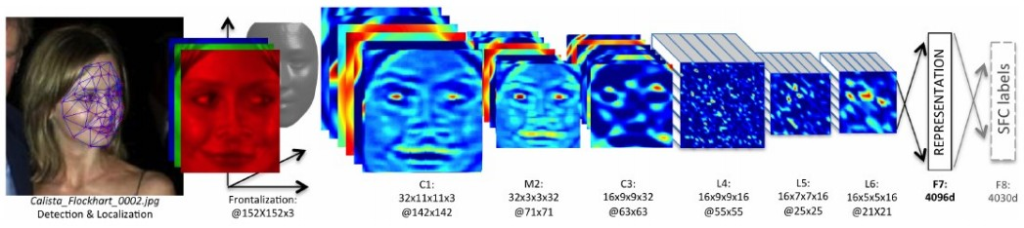
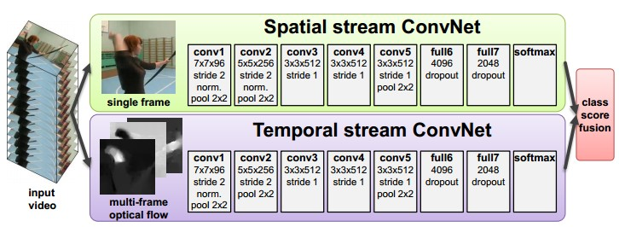
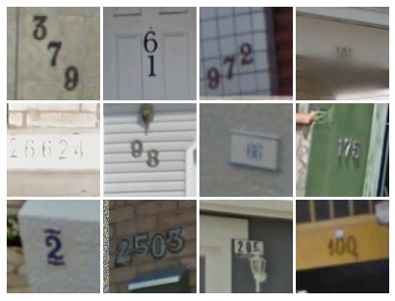
Fast-forward to today: ConvNets are everywhere
[Taigman et al. 2014]
[Goodfellow 2014]
[Simonyan et al. 2014]
42

Slide 43
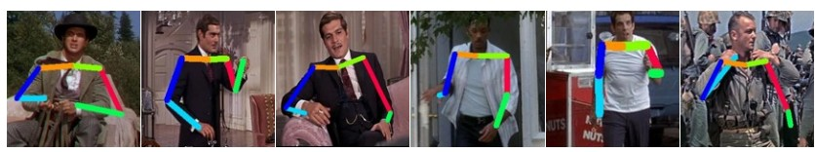
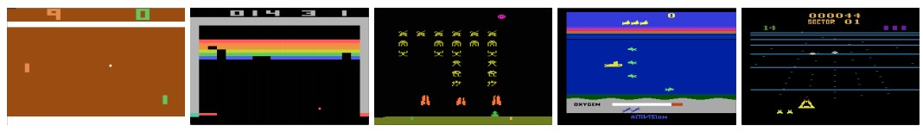
Fast-forward to today: ConvNets are everywhere
[Toshev, Szegedy 2014]
[Mnih 2013]
43

Slide 44
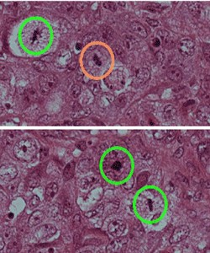
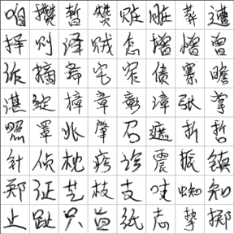
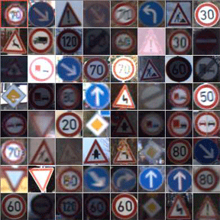
Fast-forward to today: ConvNets are everywhere
[Ciresan et al. 2013]
[Sermanet et al. 2011]
[Ciresan et al.]
44

Slide 45
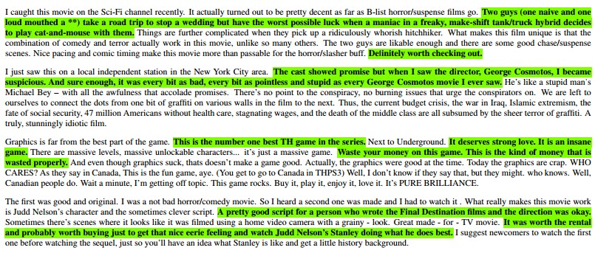
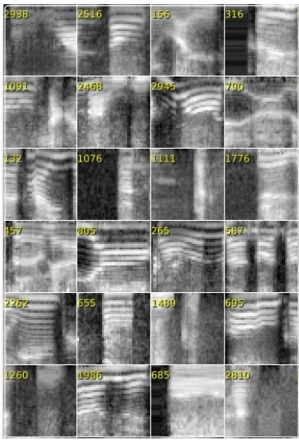
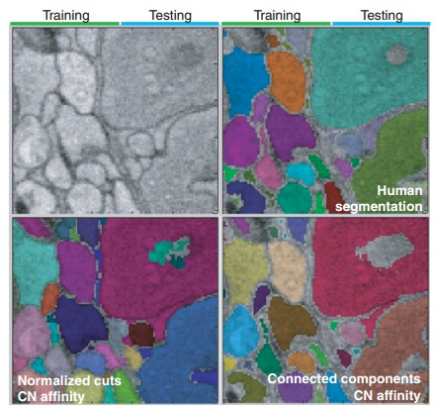
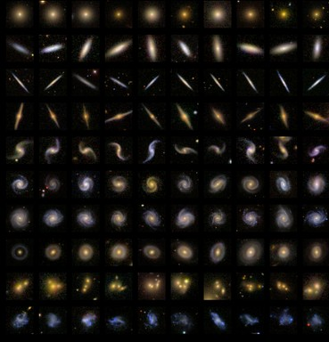
Fast-forward to today: ConvNets are everywhere
[Denil et al. 2014]
[Turaga et al., 2010]
45

Slide 46
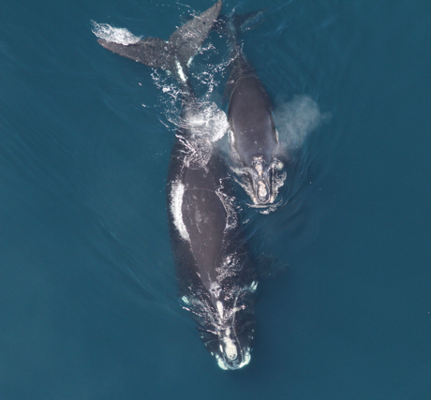
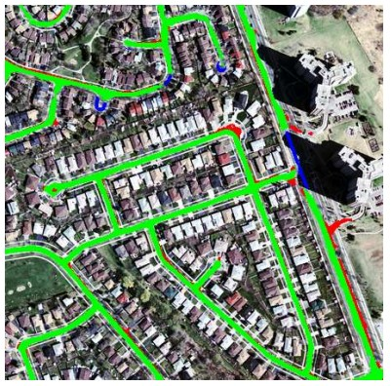
Whale recognition, Kaggle Challenge
Mnih and Hinton, 2010
46

Slide 47
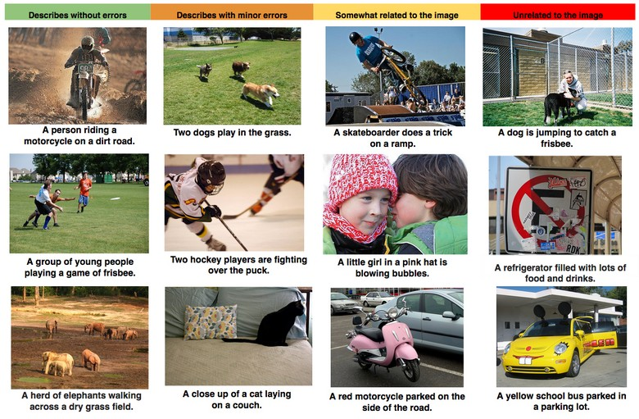
Image Captioning
[Vinyals et al., 2015]
47

Slide 48


Slide 49
Classification

Slide 50
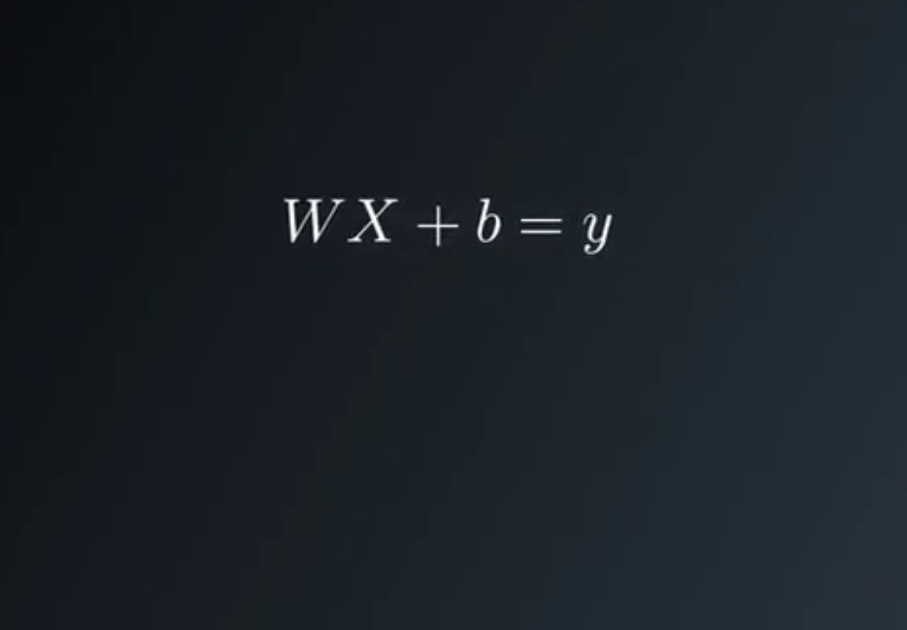
Logistic classifier

Slide 51
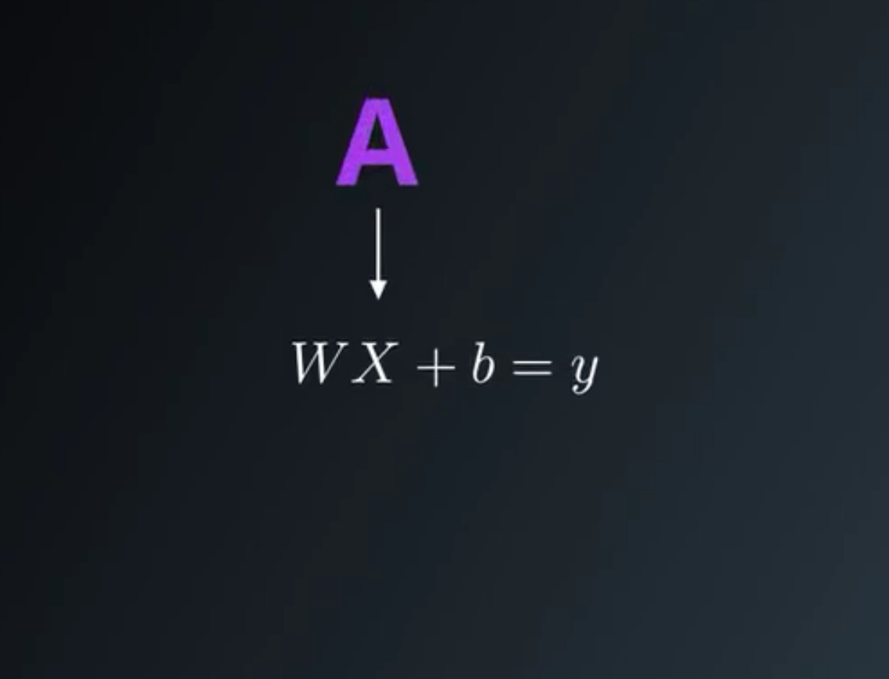

Slide 52
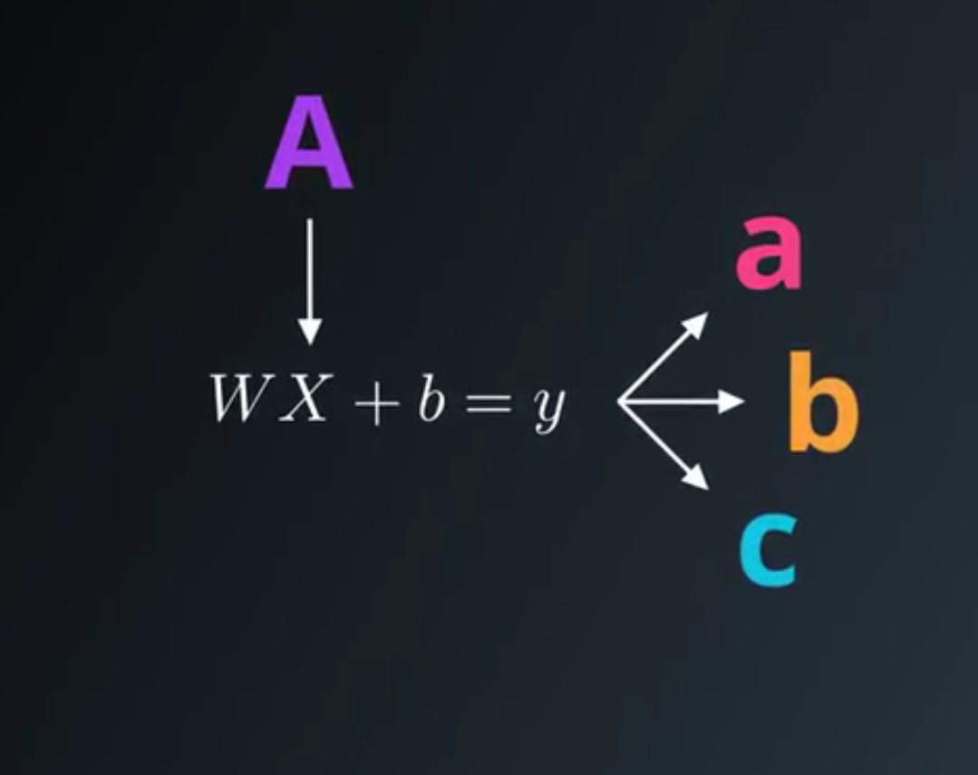

Slide 53
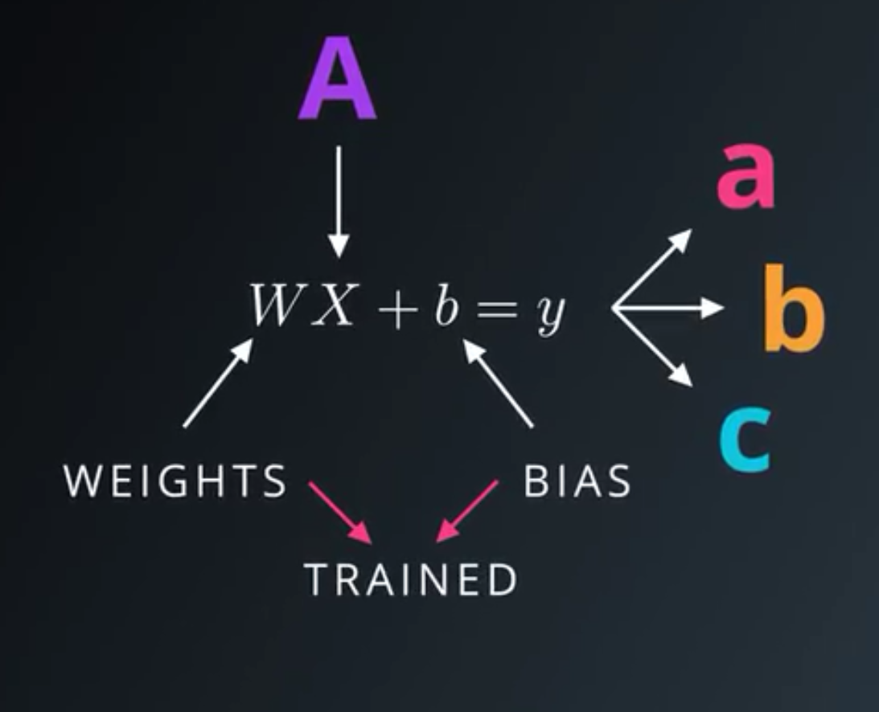

Slide 54
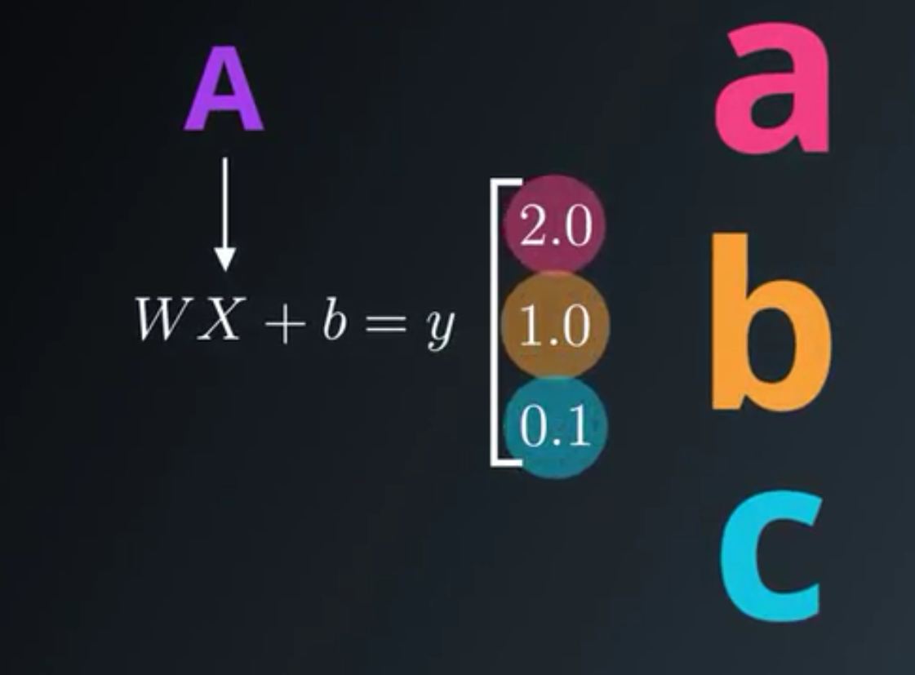

Slide 55
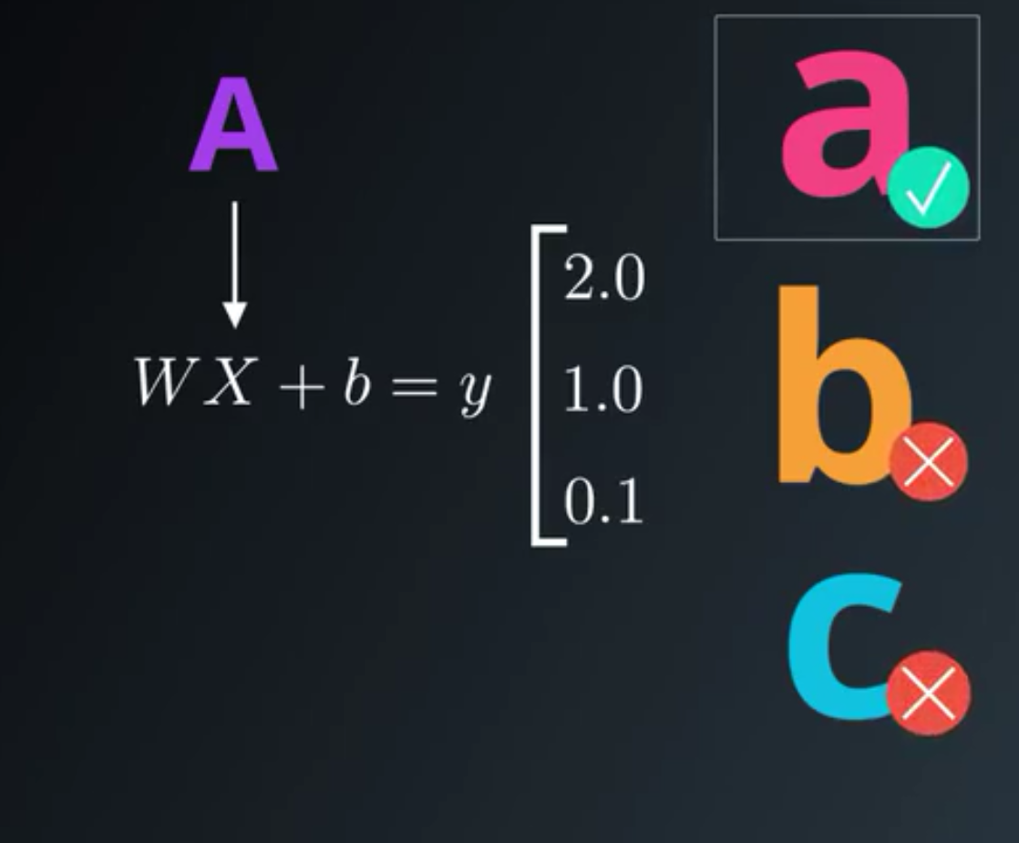

Slide 56
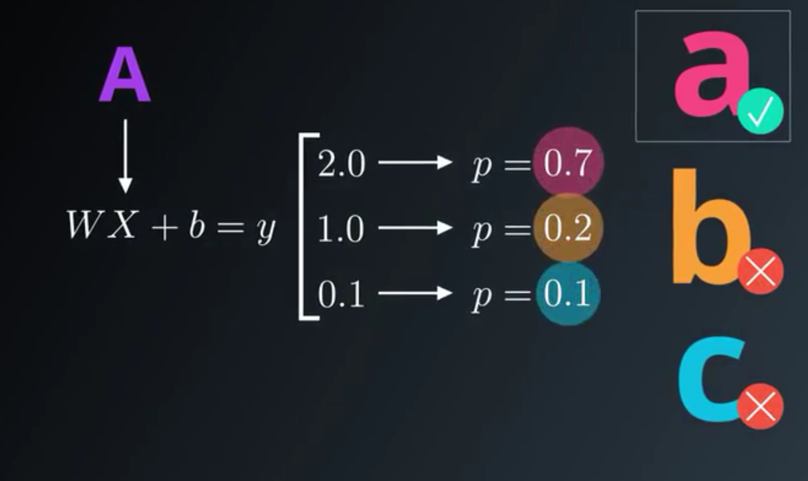

Slide 57
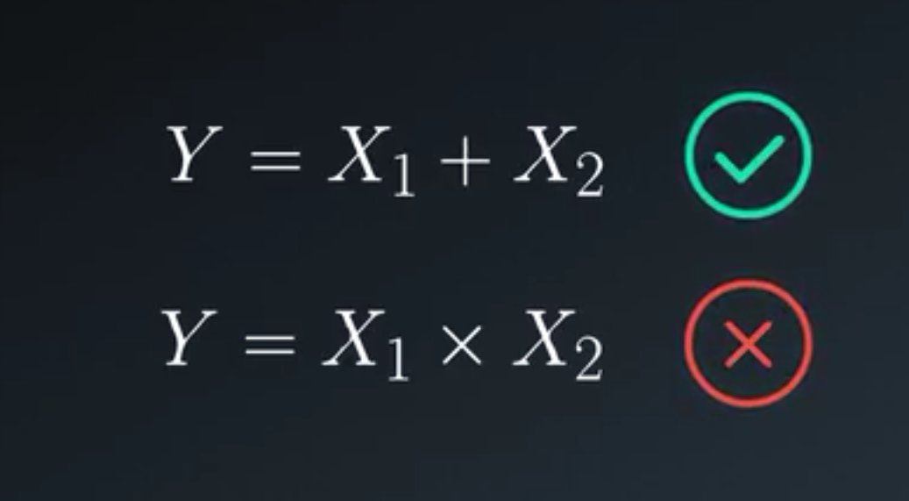

Slide 58
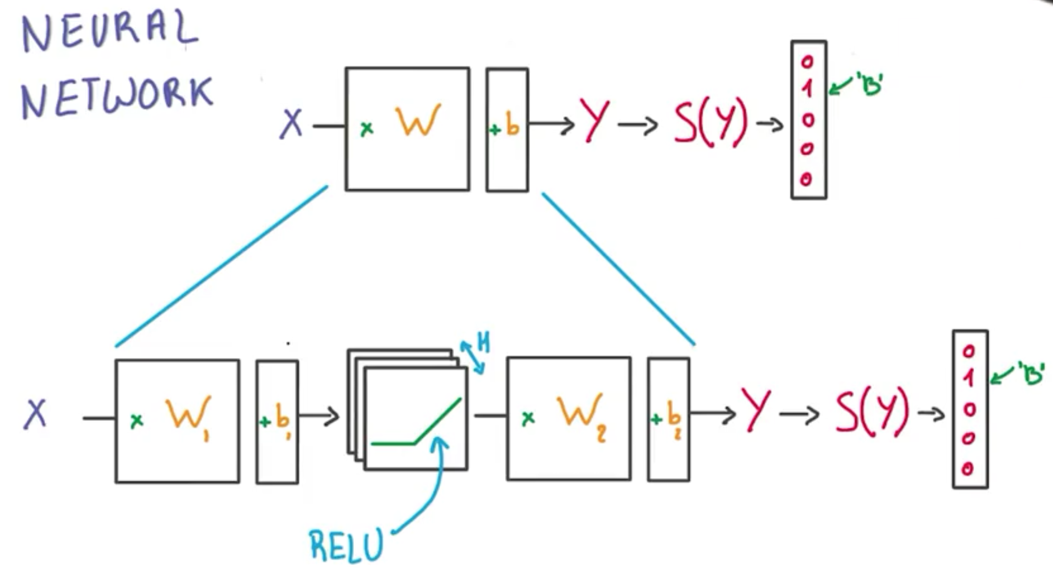

Slide 59
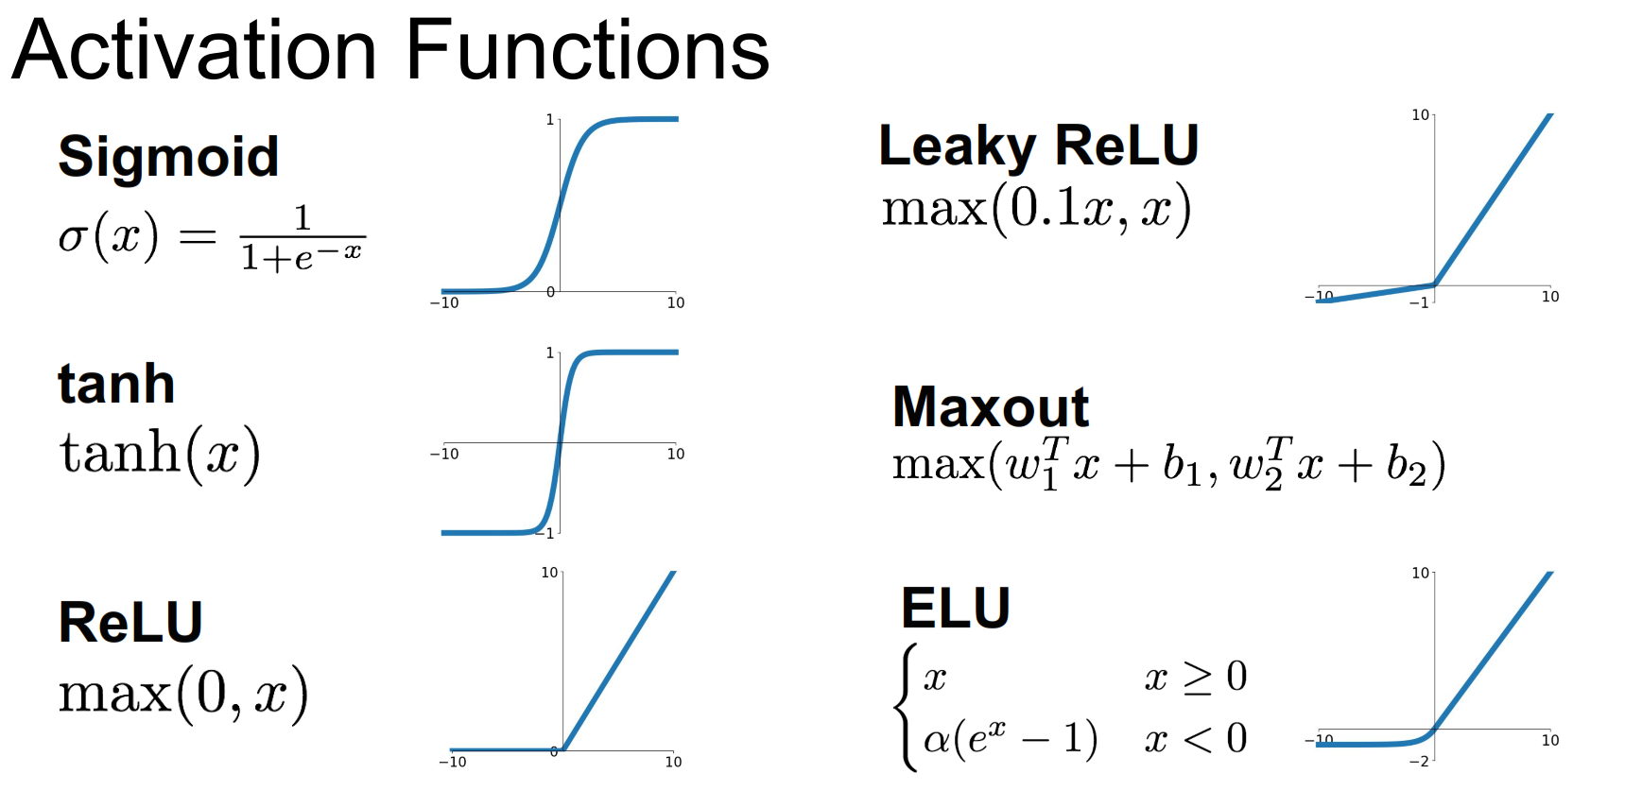

Slide 60
Mathematics!

Slide 61


Slide 62


Slide 63

One hot encoding

Slide 64


Slide 65


Slide 66


Slide 67


Slide 68


Slide 69


Slide 70


Slide 71


Slide 72
Frameworks

Slide 73


Slide 74


Slide 75


Slide 76

GPU

Slide 77


Slide 78


Slide 79


Slide 80


Slide 81


Slide 82
Question?
s.rezaeeoshternian@rug.nl
Room 340

